Slide 1
ELUCIDATING DRUG-DRUG INTERACTIONSUNDERLYING DRUG POLYPHARMACY PROFILES
Jorge Hernansanz

Slide 2
INDEX
Outline of first phase of the project
Updates
KEGG
HIV-insite interactions
Liverpool interactions
Vigibase
Crediblemeds
Phaedra
What’s left?

Slide 3
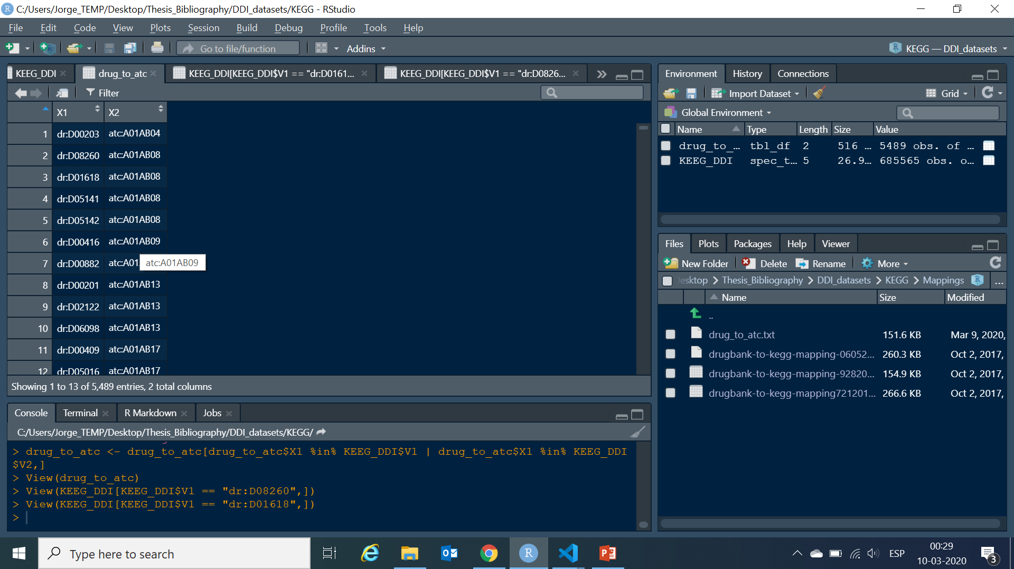
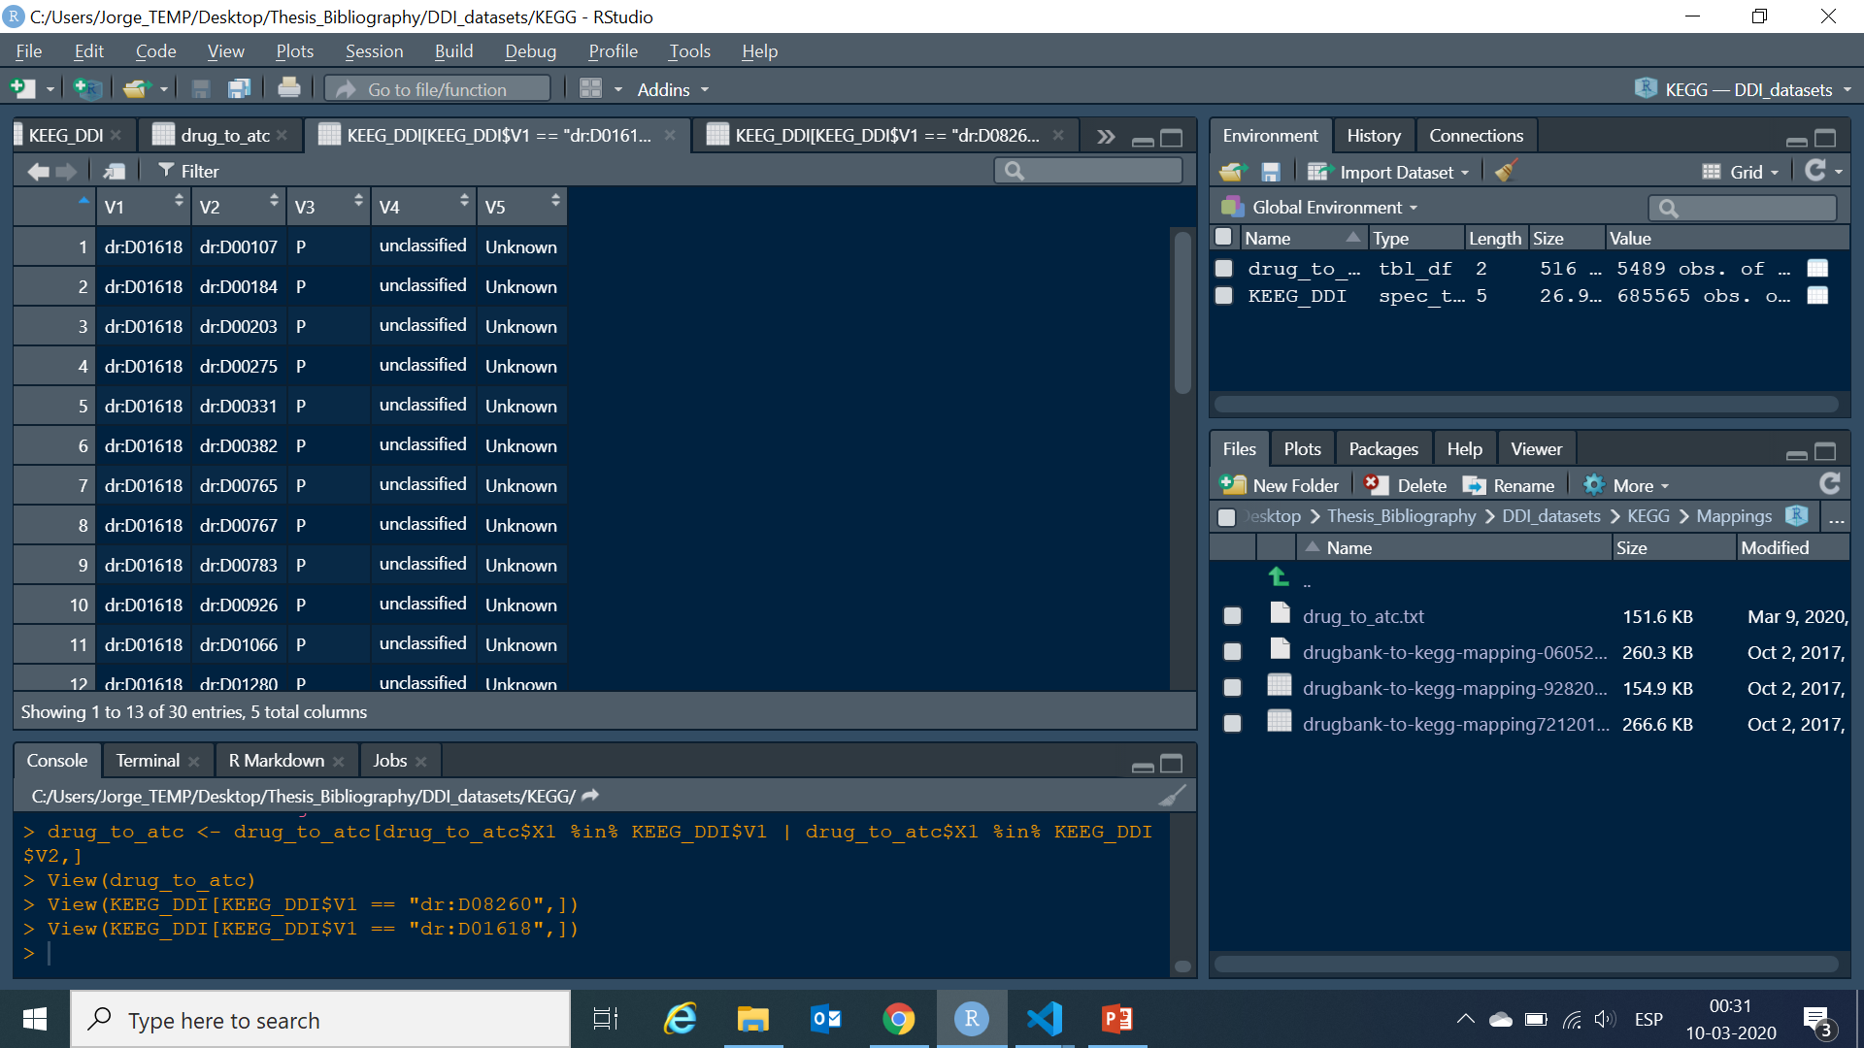
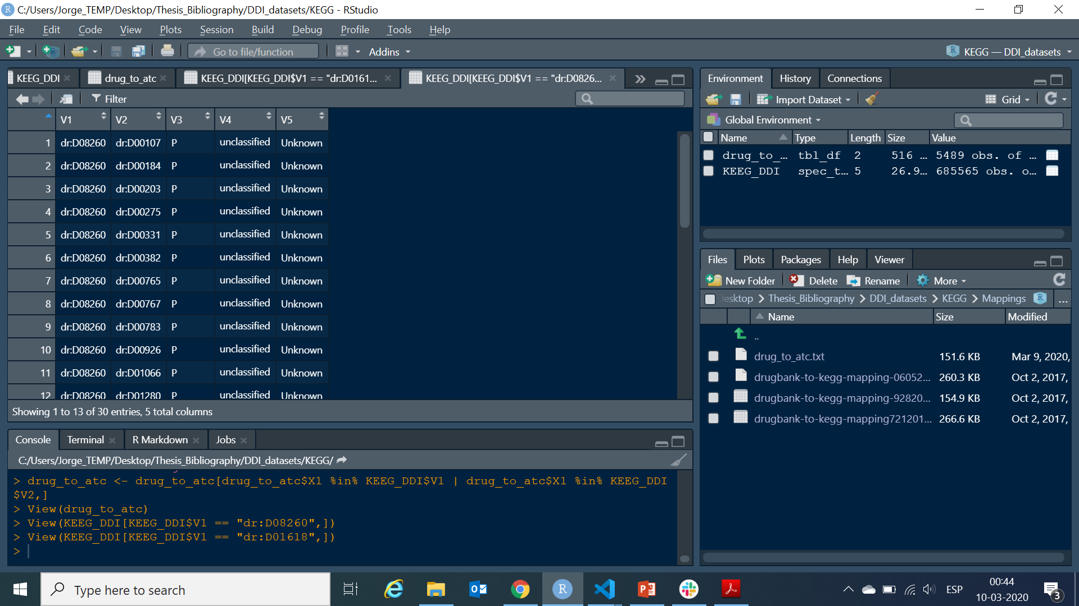
KEGG
Same chemical group
Now it can be related ATC and more information
5489, remove ATC duplicates
2964 unique ATC codes

Slide 4
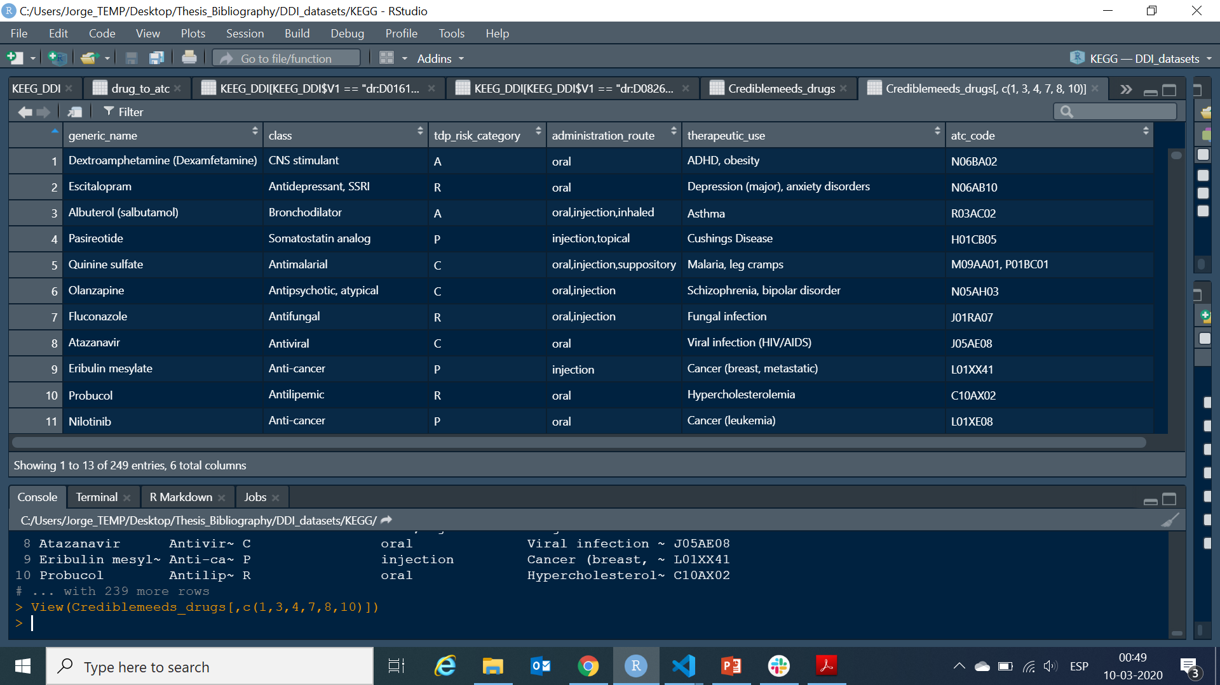
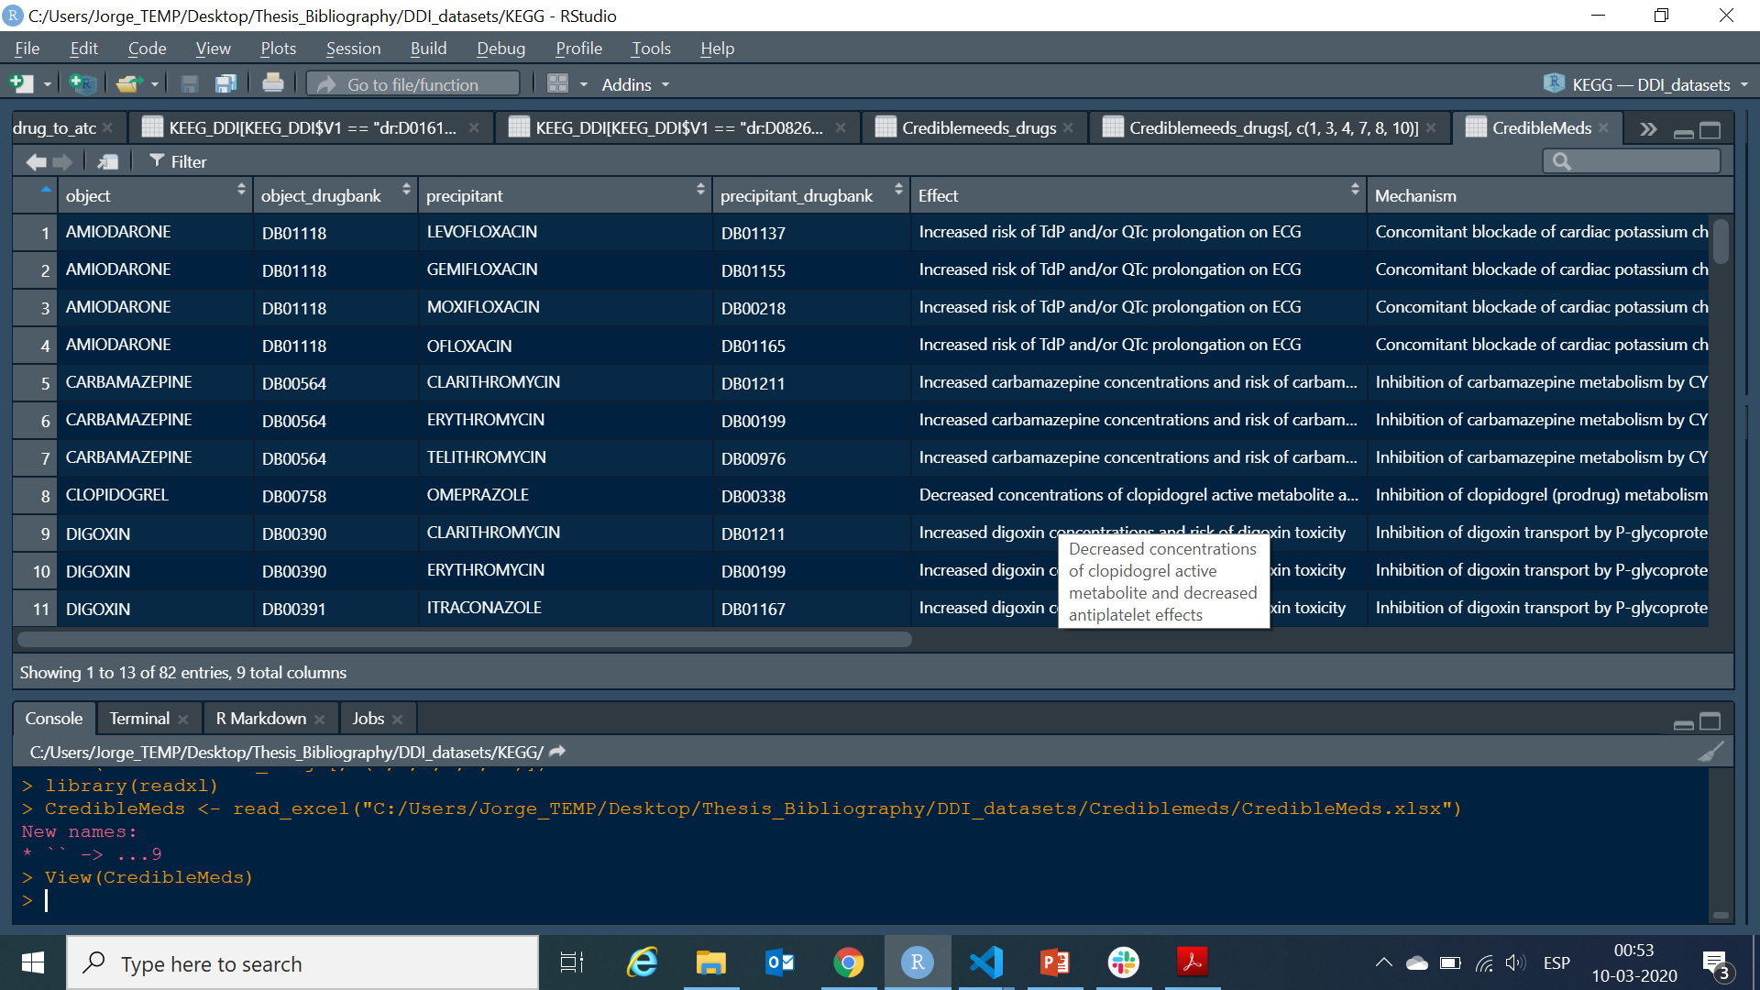
CREDIBLEMEDS

Slide 5
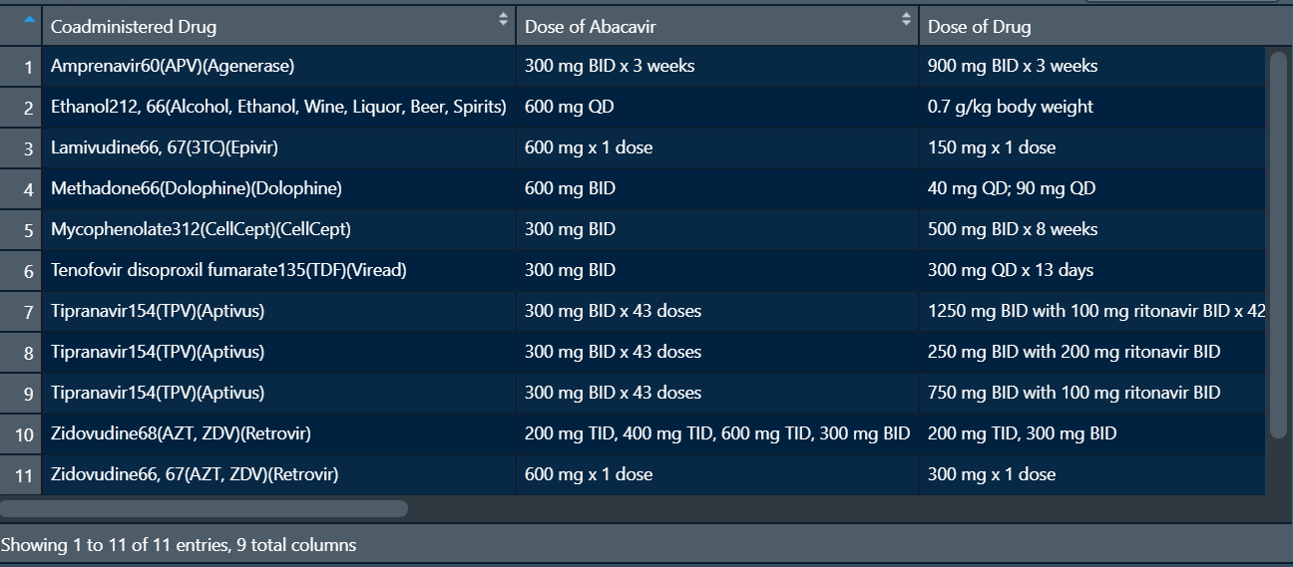
HIV-insite-interactions
Effect on Abacavir levels
Effect on drug levels
Management
Mechanism of interaction
Potential clinical effects
35 HIV-related drugs

Slide 6
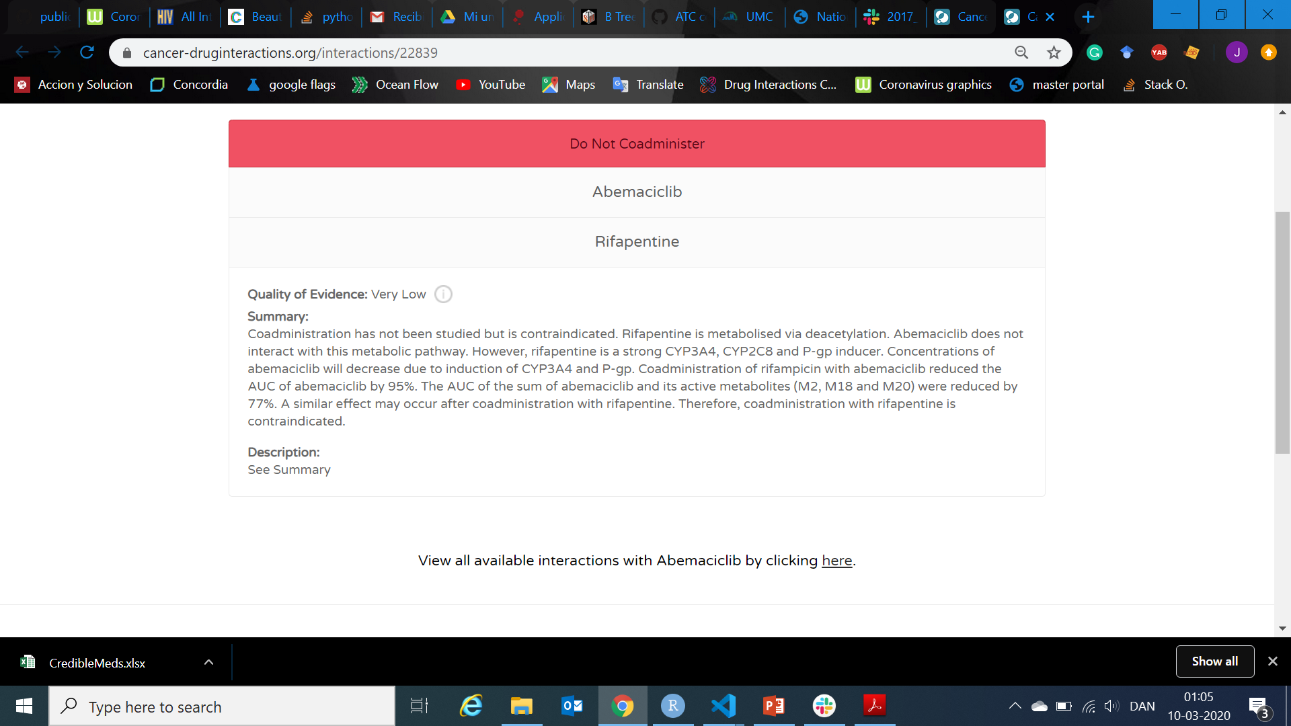
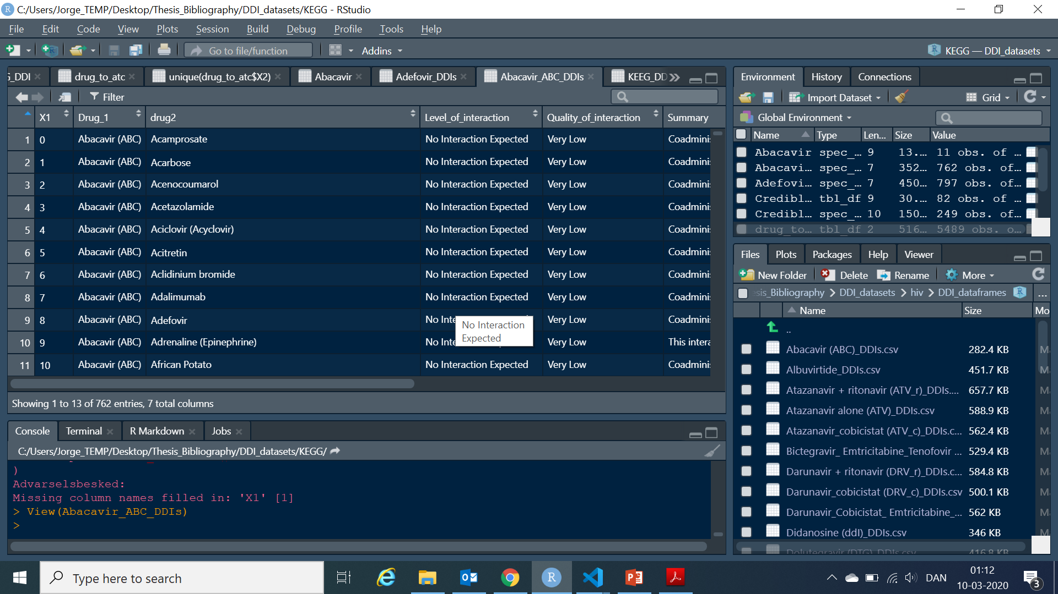
HIV, HEP, CANCER (LIVERPOOL)
20 Drugs blasted to 762 drugs

Slide 7
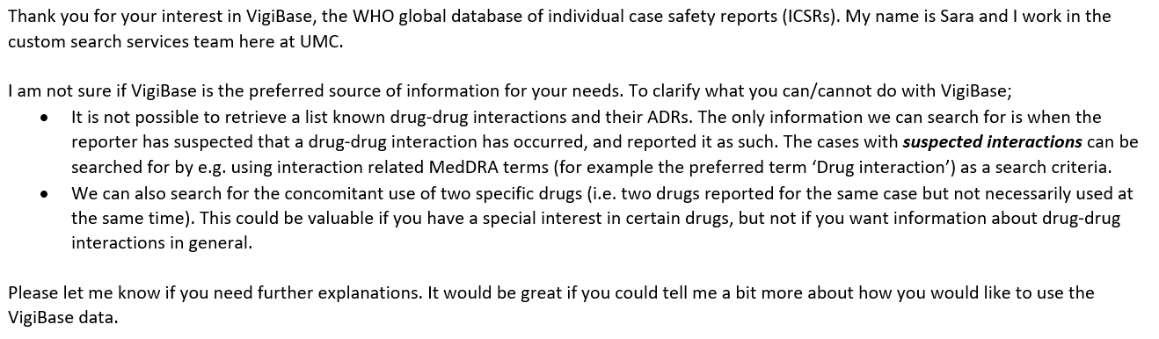
VIGIBASE

Slide 8
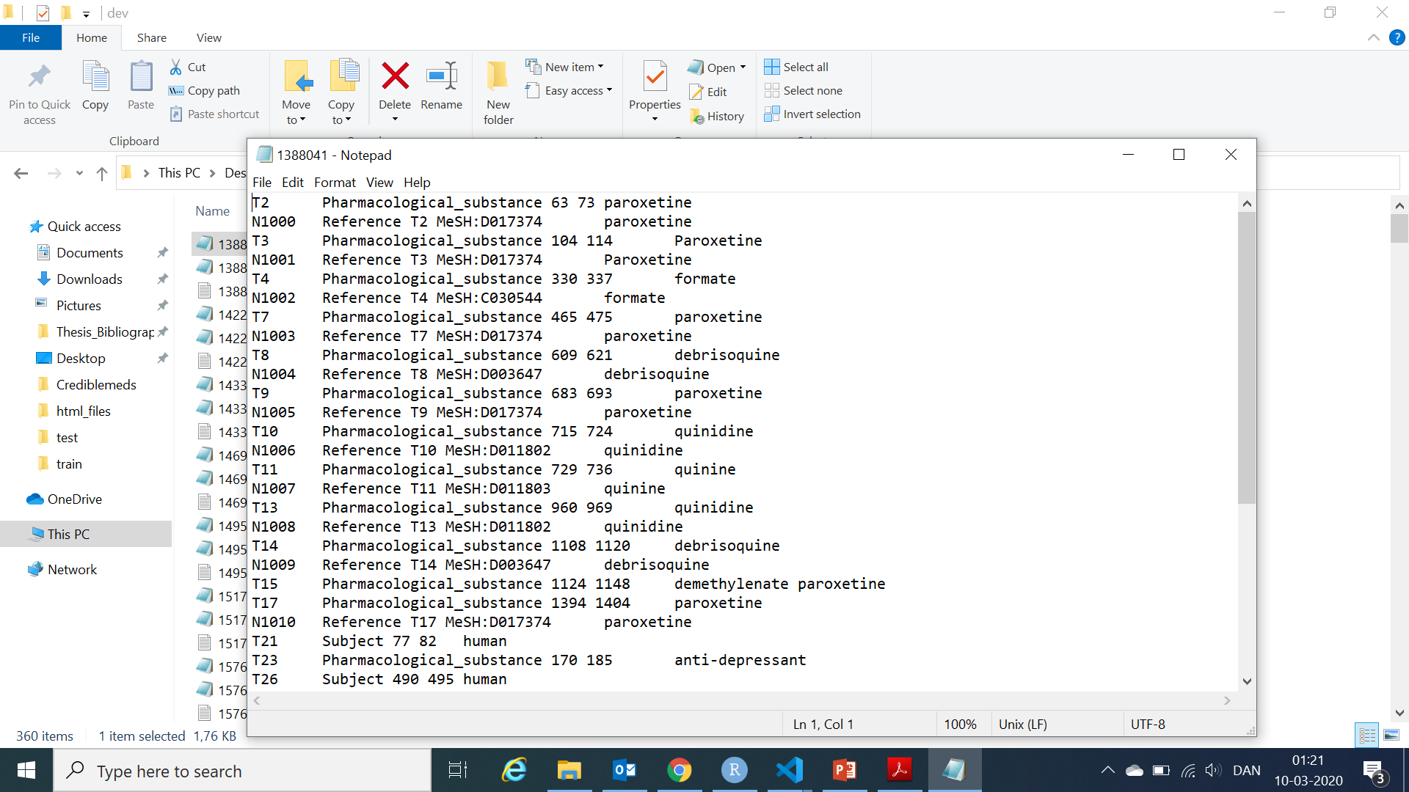
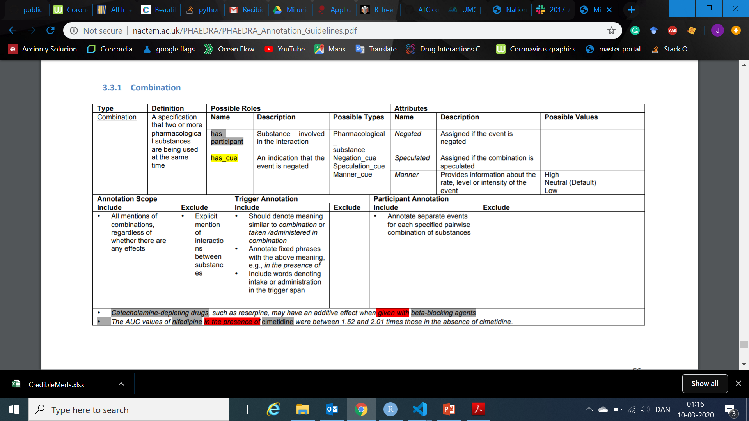
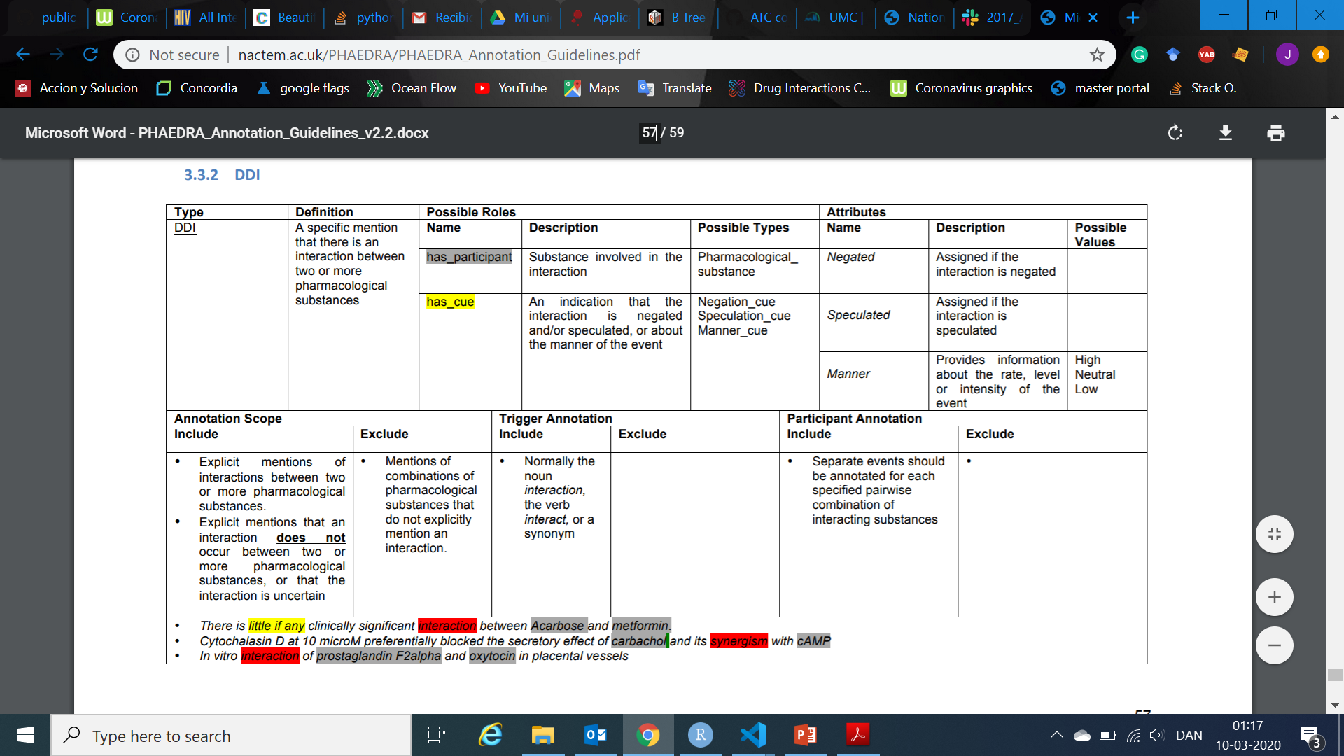
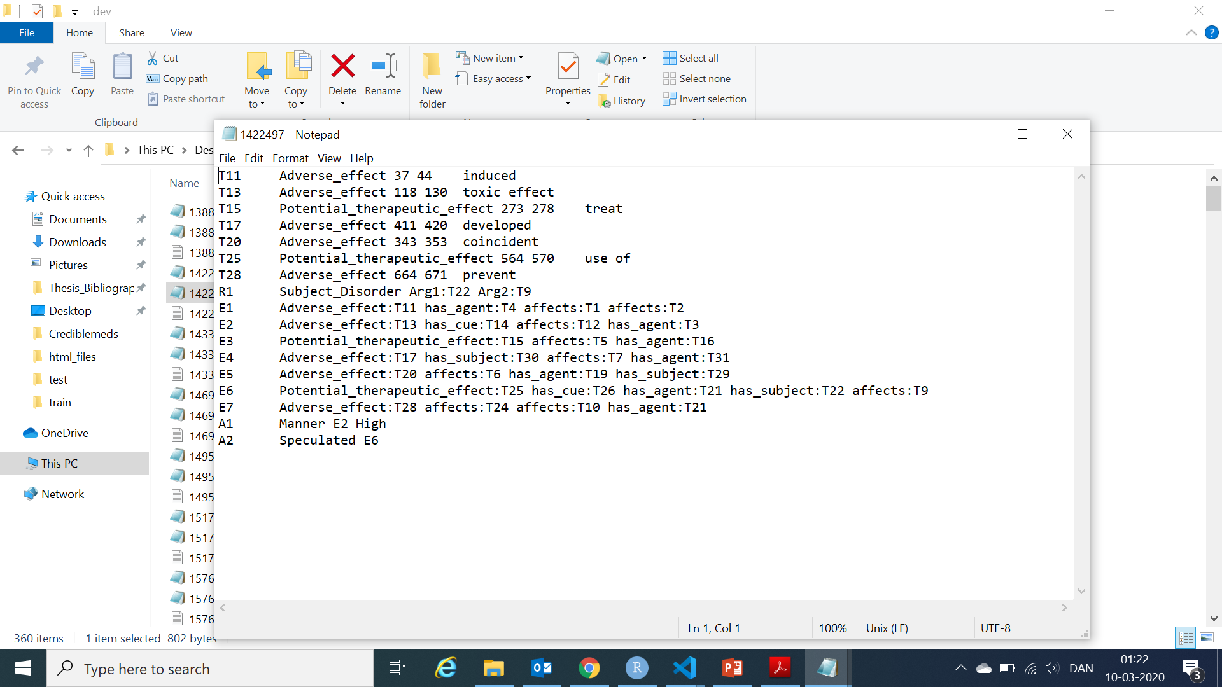
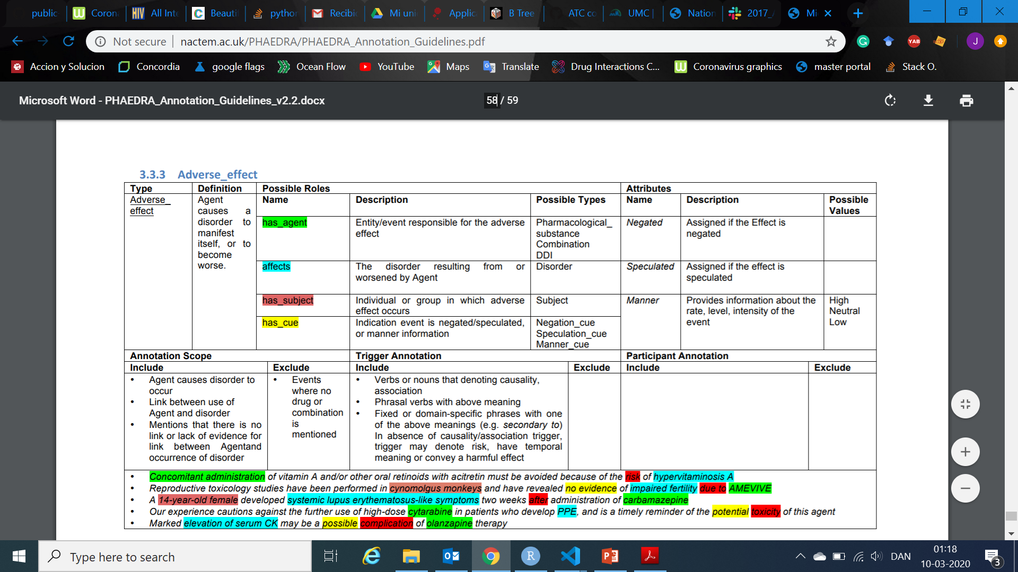
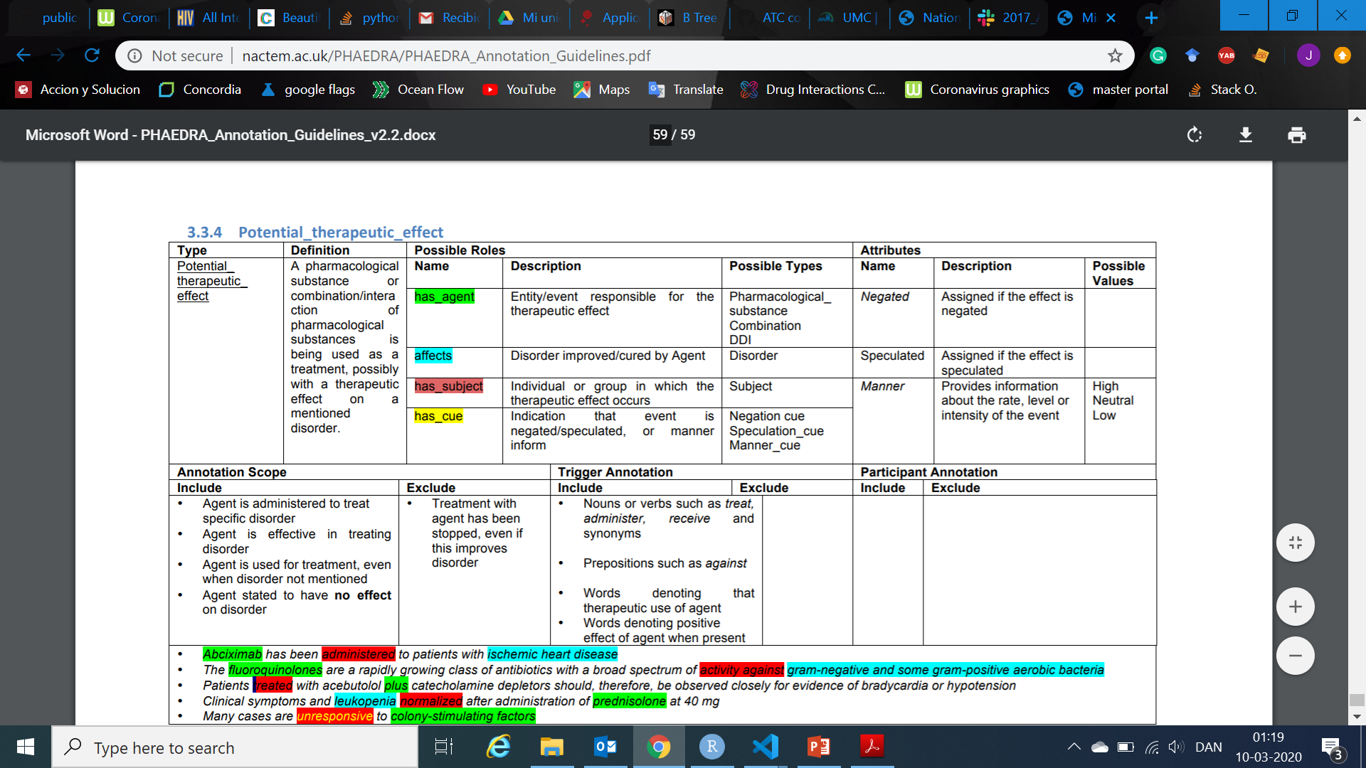
PHAEDRA

Slide 9
WHAT’S LEFT?
Link all ATC codes with databases.
Finish with Phaedra.
Make a table of features for DDIs and single drugs.
Make upsetR plots for all DDIs and an extra one for the ONCs.
Check extra ‘useful’ information of Crediblemeds and Drugbank.
Make for all databases analyzed, guidelines ( Half-made).
Comment code for recent databases. Check the oldest ones.
Upload everything to Github.

